Slide 1
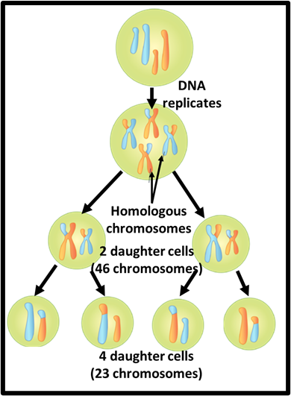

Meiosis Question
Describe the process of meiosis and its importance
Key things to include:
What is mitosis
What sort of cells does it produce
How is it different from mitosis
_______________________________________________________________________________________________________________________________________________________________________________________________________________________________________________________________________________________________________________________________________________________________________________________________________________________________________
Answer
Link to video

