Slide 1

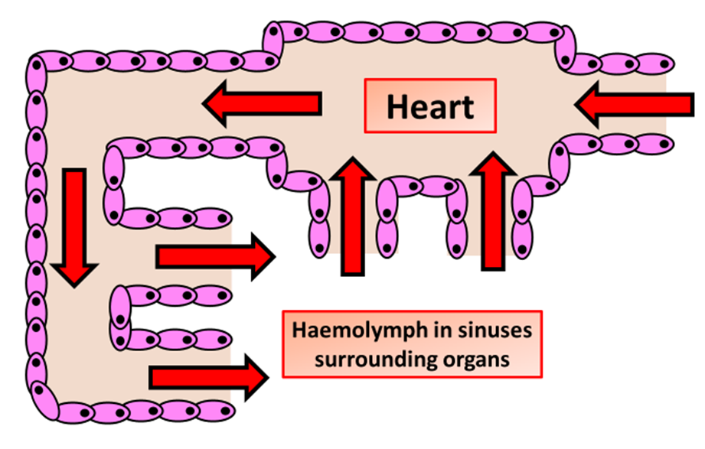

The Great Biology Pubish Quiz
Open Circulation

Slide 2

The Great Biology Pubish Quiz
Open Circulation
What is a key characteristic of an open circulatory system?
A
Blood is confined to vessels throughout the body.
Blood directly bathes the tissues.
B
C
Blood directly bathes the tissues.
D
There is no heart to pump the blood.

Slide 3
The Great Biology Pubish Quiz
Open Circulation
Which type of organism typically has an open circulatory system?
A
Mammals
Amphibians
B
C
Insects
D
Fish

Slide 4
The Great Biology Pubish Quiz
Open Circulation
In an open circulatory system, the fluid that circulates is called:
A
Plasma
Haemolymph
B
C
Blood
D
Interstitial fluid

Slide 5
The Great Biology Pubish Quiz
Open Circulation
How does haemolymph return to the heart in an open circulatory system?
A
Through veins
By diffusion
B
C
Via open-ended vessels or ostia
D
By capillary action

Slide 6
The Great Biology Pubish Quiz
Open Circulation
What is a disadvantage of an open circulatory system?
A
Limited ability to regulate blood distribution
High energy cost for circulation
B
C
Excessively high pressure in the system
D
Ineffective oxygen transport

Slide 7
The Great Biology Pubish Quiz
Open Circulation
Which of the following is NOT a feature of an open circulatory system?
A
The heart pumps haemolymph into a hemocoel.
B
Blood and interstitial fluid are mixed.
C
Found in arthropods and most mollusks.
D
Found in arthropods and most mollusks.

Slide 8

The Great Biology Pubish Quiz
Open Circulation
Question 1
B
Question 2
C
Question 3
B
Question 4
C
Question 5
A
Question 6
D

