Slide 1
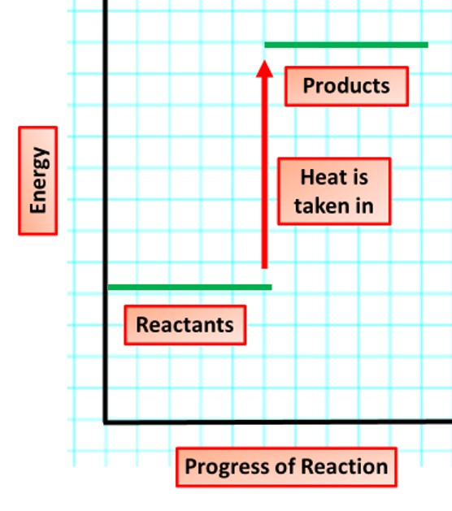

Endothermic Reactions Question
Describe what happens during an endothermic reaction and give an example.
Key things to include:
How does the energy level of reactants compare to the energy level of products
Is energy taken in or given out
_______________________________________________________________________________________________________________________________________________________________________________________________________________________________________________________________________________________________________________________________________________________________________________________________________________________________________
Answer
Link to video

