Slide 1
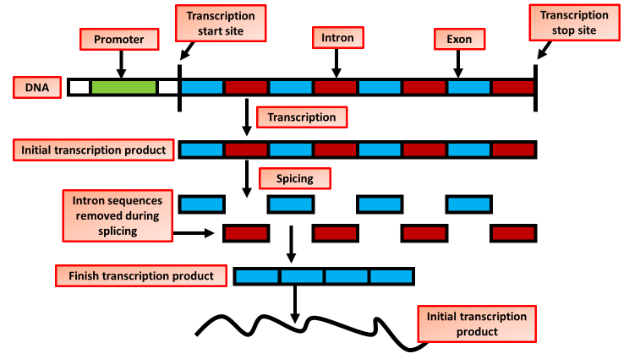
mRNA Editing Question
Explain the process and significance of mRNA editing in eukaryotic cells.
____________________________________________________________________________________________________________________________________________________________________________________________________________________________________________________________________________________________________________________________________________________________________________________________________________________________________________________________________________________________________________________________________________________________________________________
Answer
Video link

