Slide 1
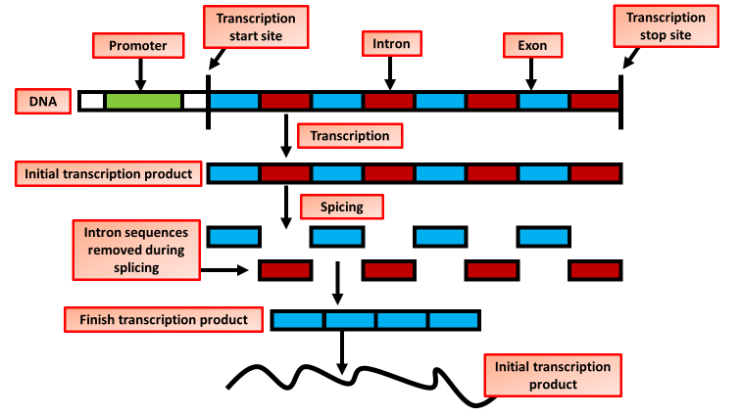

mRNA Production Question
Explain how mature mRNA is produced from pre-mRNA in eukaryotic cells.
____________________________________________________________________________________________________________________________________________________________________________________________________________________________________________________________________________________________________________________________________________________________________________________________________________________________________________________________________________________________________________________________________________________________________________________
Answer
Video link

