Slide 1
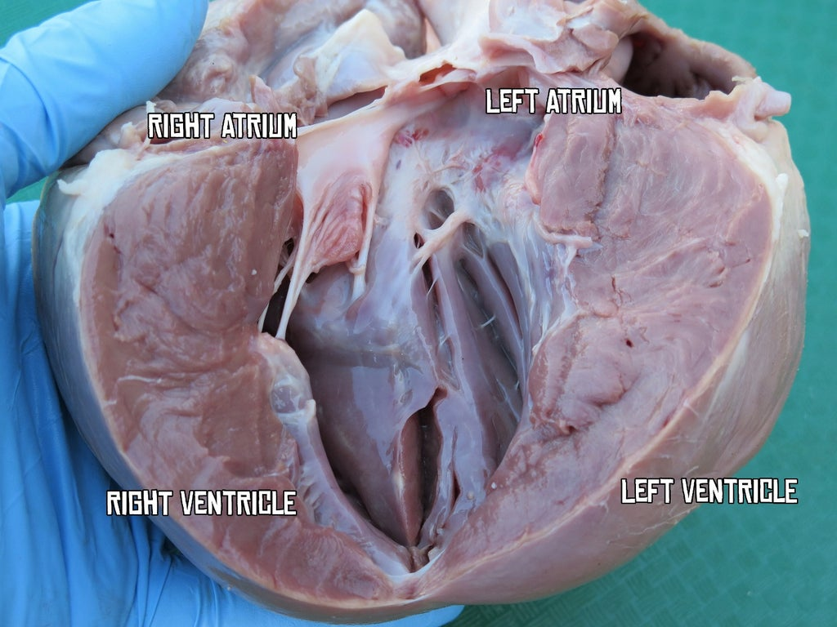

Dissection of the Mammalian Heart Question
Describe how a dissection of a mammalian heart is carried out to examine its internal structure.
____________________________________________________________________________________________________________________________________________________________________________________________________________________________________________________________________________________________________________________________________________________________________________________________________________________________________________________________________________________________________________________________________________________________________________________
Answer
Video link

