Slide 1
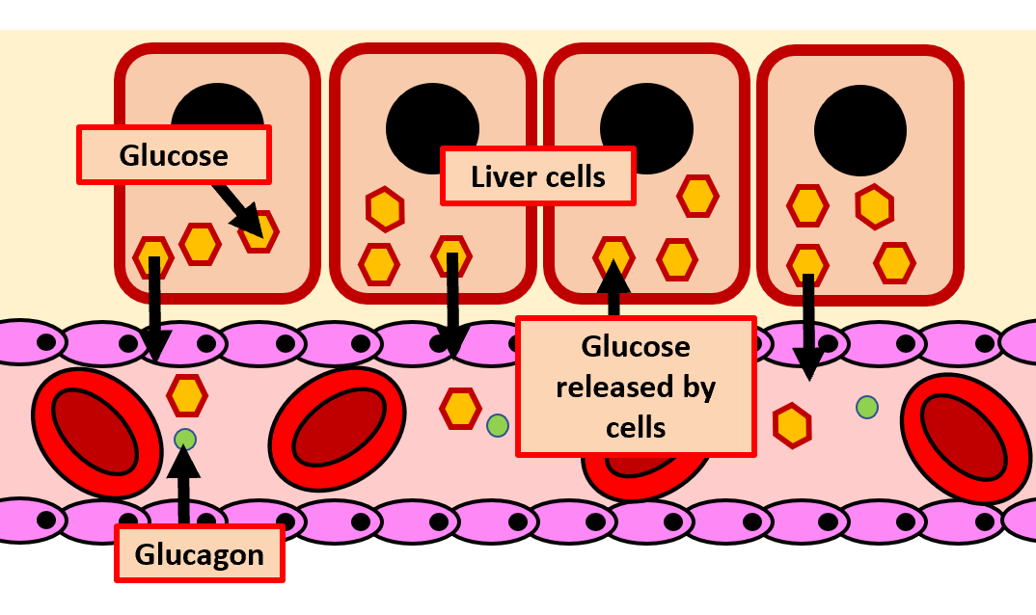
The Great Biology Pubish Quiz
Glucagon Function

Slide 2
The Great Biology Pubish Quiz
Glucagon Function
What is the primary role of glucagon in the body?
A
Increase blood glucose levels
Lower blood glucose levels
B
C
Promote protein synthesis
D
Stimulate insulin release

Slide 3
The Great Biology Pubish Quiz
Glucagon Function
Which organ is the primary target of glucagon?
A
Kidney
Liver
B
C
Pancreas
D
Stomach

Slide 4
The Great Biology Pubish Quiz
Glucagon Function
How does glucagon increase blood glucose levels?
A
By promoting glycogen breakdown
By increasing glucose absorption in the intestines
B
C
By stimulating insulin release
D
By converting glucose into glycogen

Slide 5
The Great Biology Pubish Quiz
Glucagon Function
What process is directly stimulated by glucagon in the liver?
A
Glycogenesis
Glycogenolysis
B
C
Protein synthesis
D
Fat storage

Slide 6
The Great Biology Pubish Quiz
Glucagon Function
Which of the following describes a secondary function of glucagon?
A
Stimulating gluconeogenesis
Enhancing glucose uptake by cells
B
C
Decreasing lipid metabolism
D
Reducing ketone production

Slide 7
The Great Biology Pubish Quiz
Glucagon Function
What stimulates the release of glucagon from the alpha cells of the pancreas?
A
High blood glucose levels
Elevated insulin levels
B
C
Low blood glucose levels
D
Increased lipid levels

Slide 8
The Great Biology Pubish Quiz
Glucagon Function
Question 1
A
Question 2
B
Question 3
A
Question 4
B
Question 5
A
Question 6
C

