Slide 1
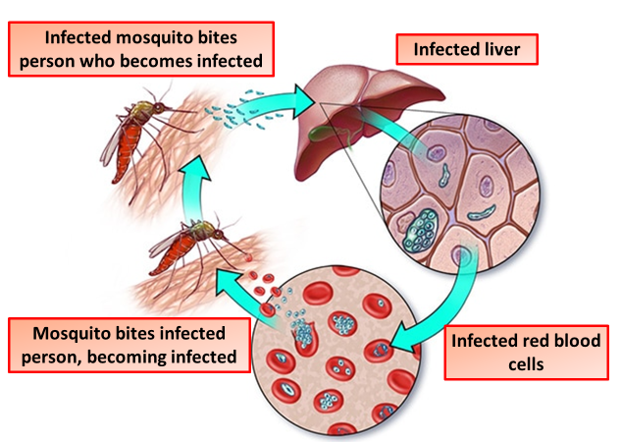

Malaria Question
Describe the cause, transmission, and effects of malaria in humans
____________________________________________________________________________________________________________________________________________________________________________________________________________________________________________________________________________________________________________________________________________________________________________________________________________________________________________________________________________________________________________________________________________________________________________________
Answer
Video link

