Slide 1

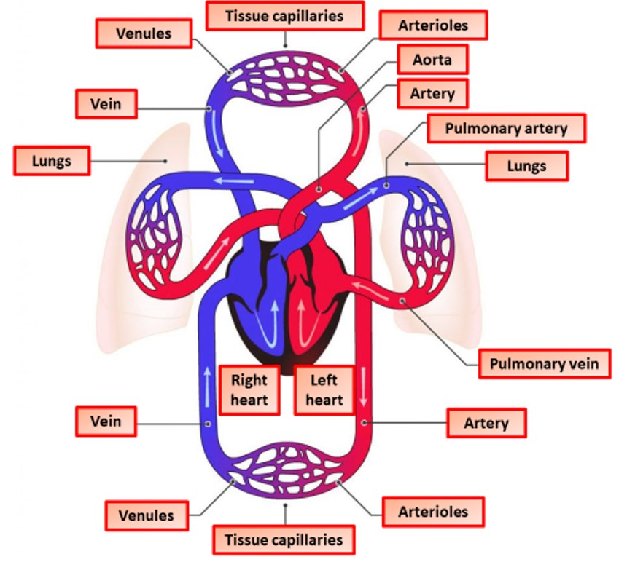

The Great Biology Pubish Quiz
Double Closed Circulation

Slide 2

The Great Biology Pubish Quiz
Double Closed Circulation
What is the main feature of a double closed circulatory system?
A
Blood passes through the heart once per circuit.
Blood flows through two separate circuits: pulmonary and systemic.
B
C
Blood is pumped directly into body cavities.
D
Blood only flows to the lungs.

Slide 3
The Great Biology Pubish Quiz
Double Closed Circulation
Which organisms typically have a double closed circulatory system?
A
Mammals
Amphibians
B
C
Insects
D
Fish

Slide 4
The Great Biology Pubish Quiz
Double Closed Circulation
What is the function of the pulmonary circuit in double closed circulation?
A
Pumping oxygenated blood to the tissues
Transporting deoxygenated blood to the lungs for oxygenation
B
C
Removing waste products from the body
D
Delivering nutrients to cells

Slide 5
The Great Biology Pubish Quiz
Double Closed Circulation
Why is double closed circulation more efficient than single circulation?
A
It allows blood to bypass the lungs.
It eliminates the need for a heart.
B
C
It limits blood flow to tissues to conserve energy.
D
It maintains high pressure in the systemic circuit for faster oxygen delivery.

Slide 6
The Great Biology Pubish Quiz
Double Closed Circulation
In the systemic circuit of double closed circulation, what happens to the oxygenated blood?
A
It is pumped to the lungs.
It mixes with deoxygenated blood.
B
C
It is distributed to the body’s tissues and organs.
D
It is stored in the heart.

Slide 7
The Great Biology Pubish Quiz
Double Closed Circulation
What is a key structural feature of the heart in organisms with double closed circulation?
A
The heart has two chambers.
B
The heart is a simple tubular structure.
C
The heart is four-chambered, separating oxygenated and deoxygenated blood.
D
The heart pumps blood directly into the hemocoel.

Slide 8

The Great Biology Pubish Quiz
Single Closed Circulation
Question 1
B
Question 2
A
Question 3
B
Question 4
D
Question 5
C
Question 6
C

