Slide 1
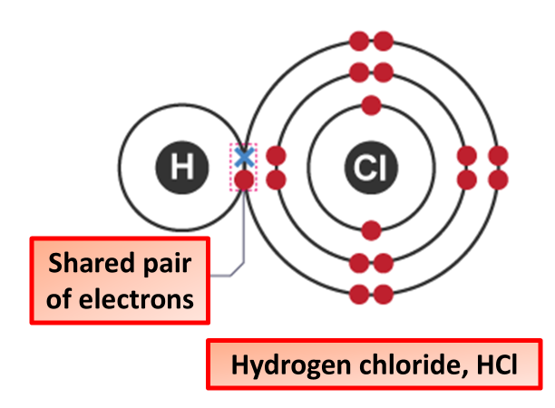

Covalent Bonding Question
The diagram shows how covalent bonds form:
Video link
What type of elements form covalent bonds?
What happens to electrons in covalent bonding?
What is a molecule?
Why do covalent compounds not conduct electricity?

