Slide 1
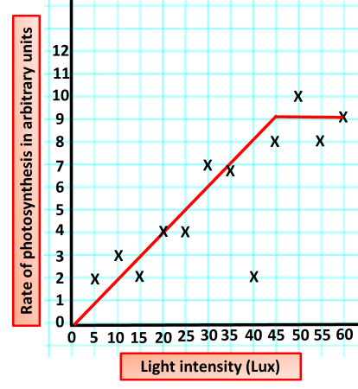

Light as a Limiting Factor Question
Explain why increasing light intensity increases the rate of glucose production in photosynthesis (up to a point).
____________________________________________________________________________________________________________________________________________________________________________________________________________________________________________________________________________________________________________________________________________________________________________________________________________________________________________________________________________________________________________________________________________________________________________________
Answer
Video link

