Slide 1

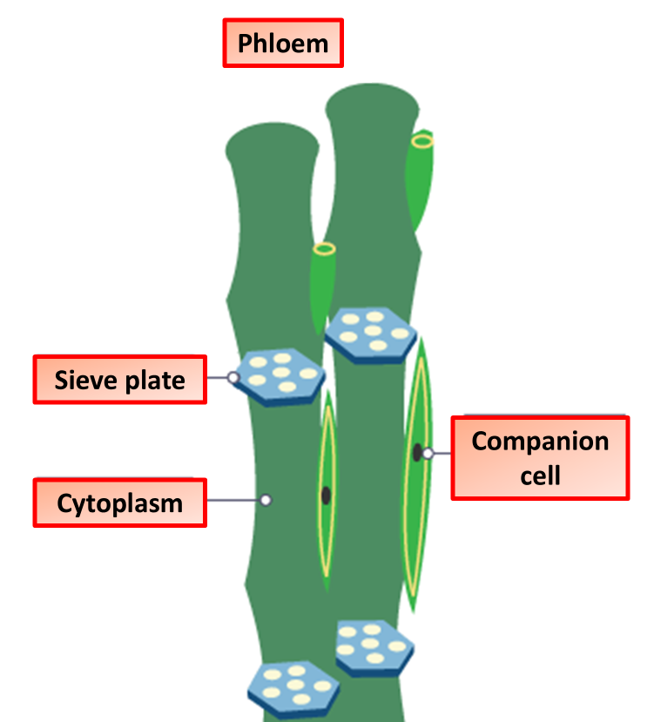

The Great Biology Pubish Quiz
Phloem

Slide 2

The Great Biology Pubish Quiz
Phloem
What is the main function of phloem?
A
Transport of water
Transport of sugars
B
C
Absorption of minerals
D
Support of the plant

Slide 3
The Great Biology Pubish Quiz
Phloem
Which process moves substances through the phloem?
A
Transpiration
Diffusion
B
C
Translocation
D
Active transport

Slide 4
The Great Biology Pubish Quiz
Phloem
What type of cells make up the phloem?
A
Guard cells and mesophyll cells
Sieve tube elements and companion cells
B
C
Xylem vessels and tracheids
D
Parenchyma and sclerenchyma

Slide 5
The Great Biology Pubish Quiz
Phloem
Which sugar is mainly transported in the phloem?
A
Glucose
Sucrose
B
C
Fructose
D
Starch

Slide 6
The Great Biology Pubish Quiz
Phloem
Which part of the plant acts as a source in translocation?
A
Roots
Stem
B
C
Mature leaves
D
Xylem

Slide 7
The Great Biology Pubish Quiz
Phloem
What is the role of companion cells in the phloem?
A
Providing ATP for active loading
B
Structural support
C
Water transport
D
Preventing pathogen entry

Slide 8

The Great Biology Pubish Quiz
Phloem
Question 1
B
Question 2
C
Question 3
B
Question 4
B
Question 5
C
Question 6
A

