Slide 1
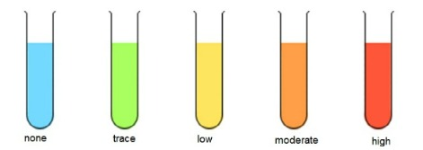

Determining Glucose Concentration Question
Describe how you would determine the concentration of glucose in an unknown solution using colorimetry.
____________________________________________________________________________________________________________________________________________________________________________________________________________________________________________________________________________________________________________________________________________________________________________________________________________________________________________________________________________________________________________________________________________________________________________________
Answer
Link to video

