Slide 1
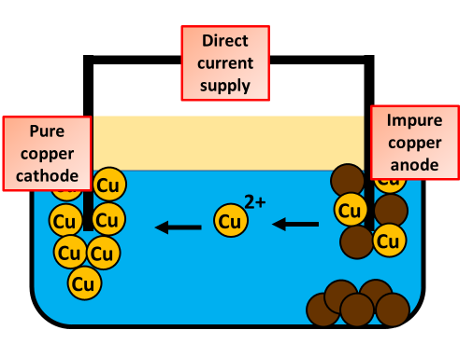

The Electrolysis of Copper Sulfate
The diagram below shows what happens during the electrolysis of copper sulfate. Describe what occurs at each electrode and the overall impact on the copper sulfate solution.
Key things to include:
What ions are formed
Where do they move
Where does oxidation & reduction happen
_____________________________________________________________________________________________________________________________________________________________________________________________________________________________________________________________________________________________________________________________________________________________________________________________________________________________________________________________________________________________________________________________________
Answer
Link to video

