Slide 1

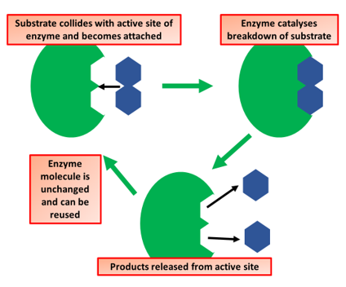

The Great Biology Pubish Quiz
Enzyme Action

Slide 2

The Great Biology Pubish Quiz
Enzyme Action
What is the name of the region on an enzyme where the substrate binds?
A
Active site
Binding site
B
C
Catalytic zone
D
Enzyme core

Slide 3
The Great Biology Pubish Quiz
Enzyme Action
What type of reaction is catalysed by enzymes?
A
Combustion
Metabolic
B
C
Oxidation
D
Radioactive

Slide 4
The Great Biology Pubish Quiz
Enzyme Action
How do enzymes lower the activation energy of a reaction?
A
By increasing substrate concentration
By changing the pH
B
C
By stabilising the transition state
D
By using more ATP

Slide 5
The Great Biology Pubish Quiz
Enzyme Action
What model explains how the enzyme changes shape to fit the substrate?
A
Lock and key model
Induced fit model
B
C
Enzyme-substrate model
D
Folding model

Slide 6
The Great Biology Pubish Quiz
Enzyme Action
Which factor does not affect enzyme activity?
A
Temperature
Substrate concentration
B
C
Pressure
D
pH

Slide 7
The Great Biology Pubish Quiz
Enzyme Action
What happens to an enzyme when it is denatured?
A
It doubles in activity
B
Its active site changes shape
C
It increases reaction rate
D
It gains more energy

Slide 8

The Great Biology Pubish Quiz
Enzyme Action
Question 1
A
Question 2
B
Question 3
C
Question 4
B
Question 5
C
Question 6
B

