Slide 1
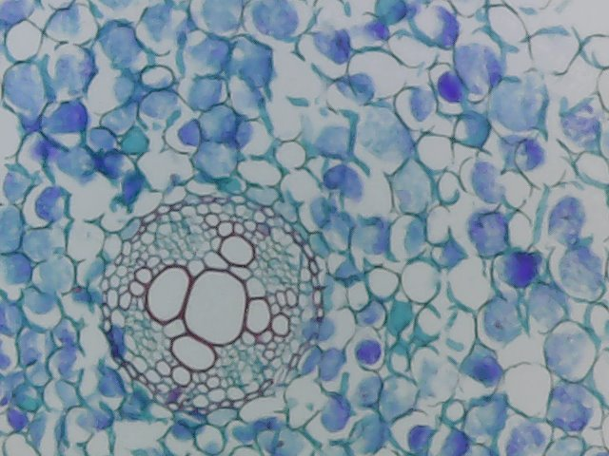

Dissection of the Stem Question
Describe how you would carry out a dissection of a plant stem to observe the distribution of vascular tissue.
____________________________________________________________________________________________________________________________________________________________________________________________________________________________________________________________________________________________________________________________________________________________________________________________________________________________________________________________________________________________________________________________________________________________________________________
Answer
Video link

