Slide 1
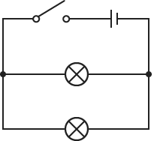

Parallel Circuits Question
The diagram shows a circuit set up in parallel. Explain how a parallel circuit works and describe its key characteristics.
Key things to include:
Describe the current
Describe the voltage
What happens if one of the bulbs go out
________________________________________________________________________________________________________________________________________________________________________________________________________________________________________________________________________________________________________________________________________________________________________________________________________________________________________
Answer
Link to video

