Slide 1

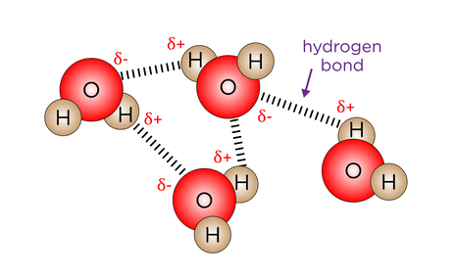

The Great Biology Pubish Quiz
Water

Slide 2

The Great Biology Pubish Quiz
Water
What type of bonding occurs between water molecules?
A
Ionic
Covalent
B
C
Metallic
D
Hydrogen

Slide 3
The Great Biology Pubish Quiz
Water
Water is described as a polar molecule because:
A
It has a high pH
It dissolves non-polar substances
B
C
It has an uneven distribution of charge
D
It lacks electrons

Slide 4
The Great Biology Pubish Quiz
Water
Which property of water helps organisms maintain a stable internal temperature?
A
Low surface tension
High latent heat of evaporation
B
C
Low specific heat capacity
D
High freezing point

Slide 5
The Great Biology Pubish Quiz
Water
Why is water an excellent solvent for biological reactions?
A
It is non-polar
It evaporates quickly
B
C
It forms hydrogen bonds with solutes
D
It has a low boiling point

Slide 6
The Great Biology Pubish Quiz
Water
How does water help in the transport of substances in plants?
A
By carrying oxygen through xylem
Through its adhesive and cohesive properties
B
C
By diffusing through stomata
D
By breaking down solutes

Slide 7
The Great Biology Pubish Quiz
Water
Ice is less dense than liquid water because:
A
Water molecules lose all movement
B
Hydrogen bonds break completely
C
Water molecules spread out in a lattice
D
There are no hydrogen bonds in ice

Slide 8

The Great Biology Pubish Quiz
Water
Question 1
D
Question 2
C
Question 3
B
Question 4
C
Question 5
B
Question 6
C

