Slide 1
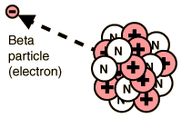

Beta Radiation Question
Describe the properties of beta radiation and explain one way it can be harmful to living organisms. (4 marks)
Key things to include:
What makes up Beta radiation
What are it’s properties
What effect will it have on cells
___________________________________________________________________________________________________________________________________________________________________________________________________________________________________________________________________________________________________________________________________________________________________________________________________________________________________________________________________________________________________________________________________________________________________________________________________________________________________
Answer
Link to video

