Slide 1
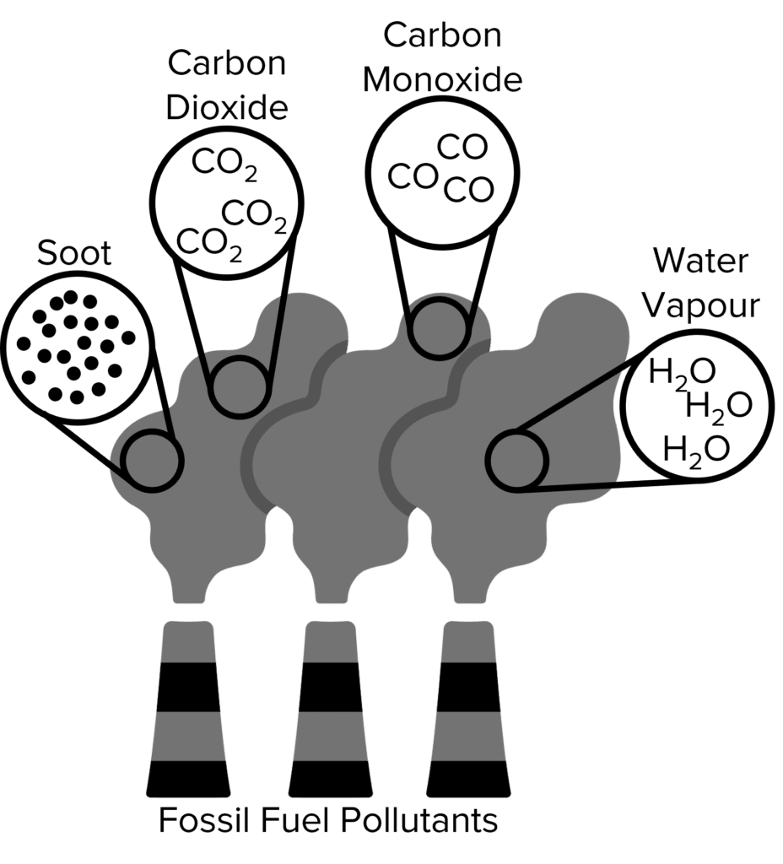

Atmospheric Pollutants Question
The diagram shows some atmospheric pollutants. Describe the main atmospheric pollutants and explain their effects on the environment.
Key things to include:
What are the effects of particular matter, sulfur dioxide, carbon dioxide and carbon monoxide
_______________________________________________________________________________________________________________________________________________________________________________________________________________________________________________________________________________________________________________________________________________________________________________________________________________________________________
Answer
Link to video

