Slide 1
Vaccination Question
Scientists have been working to produce a vaccine for HIV for many years.
Explain how a vaccine for HIV could work to prevent a person developing HIV infection.
Key things to include:
What do white blood cells recognise
What do white blood cells produce
How are pathogens affected
How does this help with long term immunity
______________________________________________________________________________________________________________________________________________________________________________________________________________________________________________________________________________________________________________________________________________________________________________________________________________________________________________________________________________________
Answer
Link to video

Slide 2
Vaccination Question

Slide 3
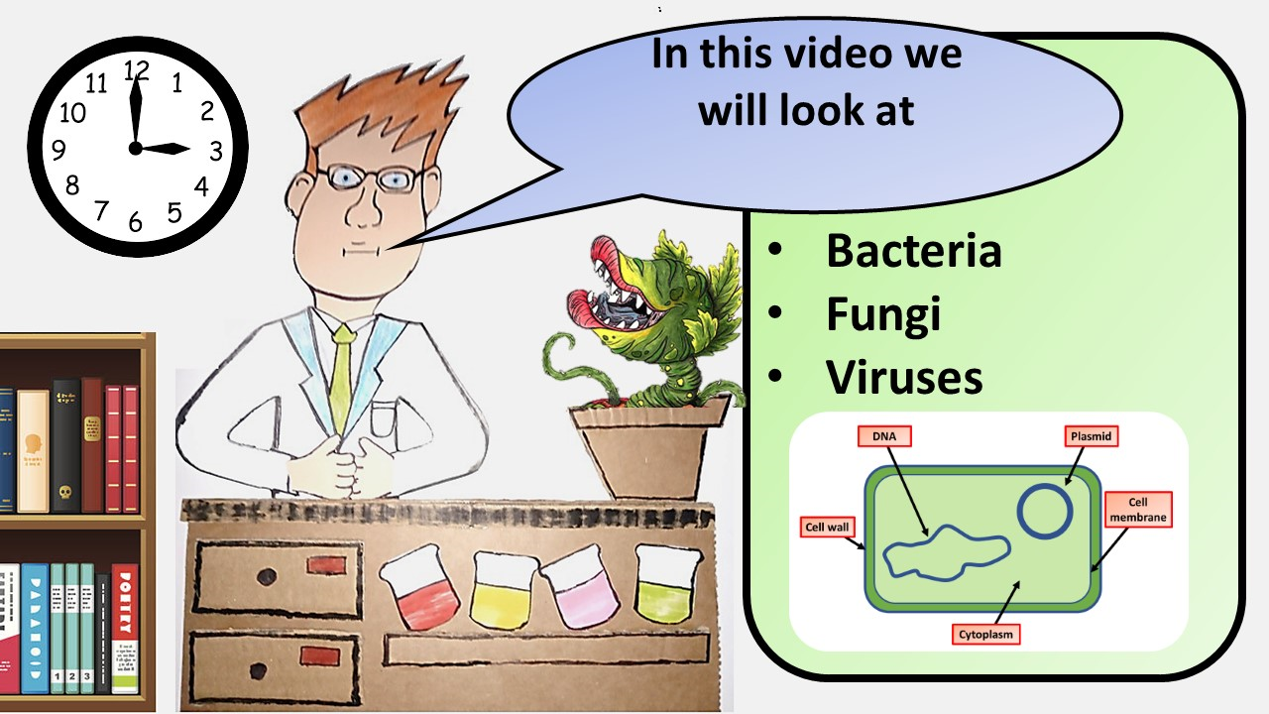
Click here to access my Pathogens youtube videos
Resources that this activity would work well with
Lesson on TES
Lesson on TPT
Follow me on social media to stay in touch
Keep up to date with my new content:

