Slide 1

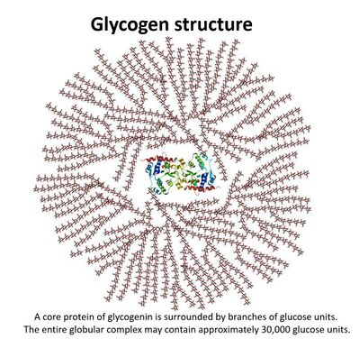

The Great Biology Pubish Quiz
Glycogen

Slide 2

The Great Biology Pubish Quiz
Glycogen
What is the primary role of glycogen in animals?
A
Structural support
Energy storage
B
C
Hormone production
D
Water transport

Slide 3
The Great Biology Pubish Quiz
Glycogen
In which organ is glycogen mainly stored?
A
Kidney
Heart
B
C
Liver
D
Pancreas

Slide 4
The Great Biology Pubish Quiz
Glycogen
Glycogen is made up of which type of monomer?
A
Fructose
Galactose
B
C
Glucose
D
Sucrose

Slide 5
The Great Biology Pubish Quiz
Glycogen
What type of bonds link the glucose units in glycogen?
A
Peptide and ester bonds
Glycosidic bonds
B
C
Hydrogen bond
D
Phosphodiester bonds

Slide 6
The Great Biology Pubish Quiz
Glycogen
Why is glycogen a suitable energy storage molecule in animals?
A
It is very soluble in water
It is a simple molecule
B
C
It is compact and can be rapidly hydrolysed
D
It is made of fats

Slide 7
The Great Biology Pubish Quiz
Glycogen
How does the structure of glycogen differ from starch?
A
Glycogen is less branched than starch
B
Glycogen is not made from glucose
C
Glycogen is more branched than amylopectin
D
Glycogen contains amino acids

Slide 8

The Great Biology Pubish Quiz
Glycogen
Question 1
B
Question 2
C
Question 3
C
Question 4
B
Question 5
C
Question 6
C

