Slide 1
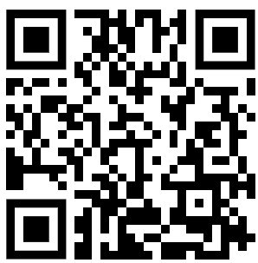
Glucose Concentration Investigation Errors Question
A student was asked to determine the glucose concentration of an unknown solution using a colourimeter and Benedict’s reagent. The student tested several known glucose concentrations, heated all solutions in a water bath, and measured colour changes using a colourimeter. However, they did not use a calibration curve, used different volumes of Benedict’s reagent, and allowed samples to cool for different times before using the colourimeter.
Identify two significant errors in the student's method. For each, explain why it is incorrect and suggest a correction
________________________________________________________________________________________________________________________________________________________________________________________________________________________________________________________________________________________________________________________________________________________________________________________________________________________________________________________________________________________________________________________________________
Answer
Video link

