Slide 1
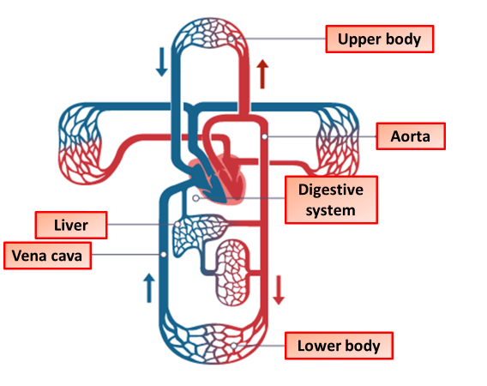

Blood Vessels Question
The diagram shows the circulatory system:
Video link
What are the three main types of blood vessels?
Which type of blood vessel has the thinnest walls?
Which blood vessels have valves to prevent backflow?
Which type of blood vessel has the highest blood pressure?

