Slide 1
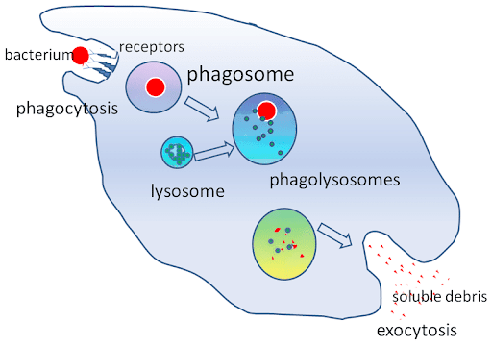

Phagocytosis Question
Describe the process of phagocytosis and explain its importance in the immune response.
___________________________________________________________________________________________________________________________________________________________________________________________________________________________________________________________________________________________________________________________________________________________________________________________________________________________________________________________________________________________________________________________________________________________________________________________________________________________________
Answer
Link to video

