Slide 1

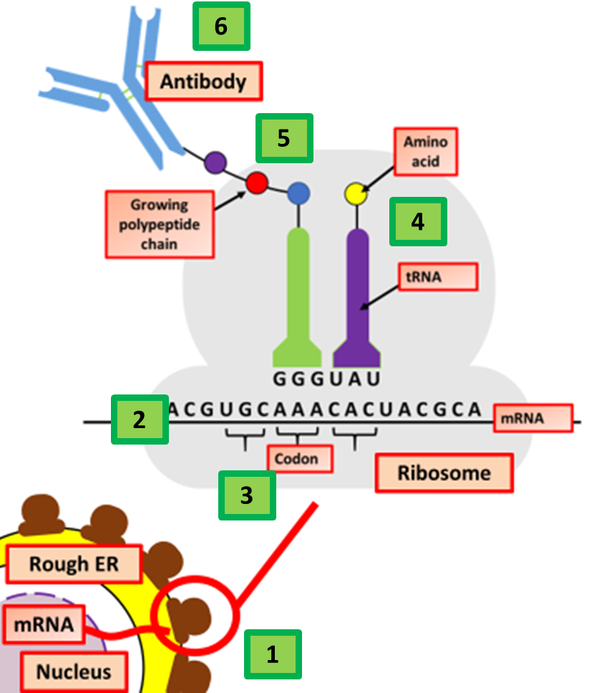

The Great Biology Pubish Quiz
Translation

Slide 2

The Great Biology Pubish Quiz
Translation
What is the primary role of tRNA in translation?
A
To carry amino acids to the ribosome
To transcribe DNA into RNA
B
C
To catalyze peptide bond formation
D
To signal the end of translation

Slide 3
The Great Biology Pubish Quiz
Translation
Which structure is the site of translation?
A
Golgi apparatus
Ribosome
B
C
Endoplasmic reticulum
D
Nucleus

Slide 4
The Great Biology Pubish Quiz
Translation
What is the main function of tRNA in translation?
A
To produce ribosomal subunits
To carry specific amino acids to the ribosome
B
C
To transcribe DNA into RNA
D
To signal the termination of translation

Slide 5
The Great Biology Pubish Quiz
Translation
How are amino acids joined together during translation?
A
By hydrogen bonds
By covalent bonds
B
C
By peptide bonds
D
By ionic bonds

Slide 6
The Great Biology Pubish Quiz
Translation
Which part of the ribosome binds to the mRNA?
A
Large subunit
Small subunit
B
C
Anticodon loop
D
tRNA-binding site

Slide 7
The Great Biology Pubish Quiz
Translation
What is the function of the stop codon in translation?
A
To bind to tRNA and continue elongation
B
To initiate translation
C
To attract ribosomal subunits
D
To release the polypeptide chain from the ribosome

Slide 8

The Great Biology Pubish Quiz
Translation
Question 1
A
Question 2
B
Question 3
B
Question 4
C
Question 5
B
Question 6
D

