Slide 1
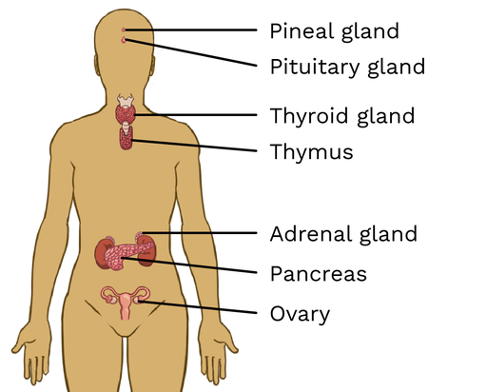

Endocrine System Question
The diagram below shows the endocrine system
Video Link
What is the main function of the endocrine system?
Which gland produces insulin?
What hormone is released by the adrenal glands in response to stress?
Which gland controls other glands in the endocrine system?

