Slide 1
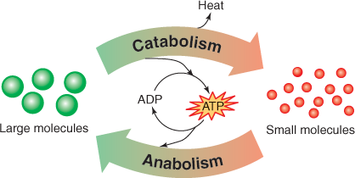

Metabolism Question
Describe what metabolism is and why it is important.
Key things to include:
Why is metabolism important
What is anabolism
What is catabolism
_______________________________________________________________________________________________________________________________________________________________________________________________________________________________________________________________________________________________________________________________________________________________________________________________________________________________________
Answer
Link to video

