Slide 1
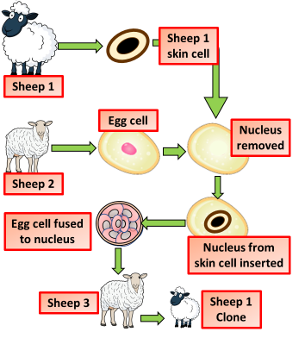

Cloning Question
Describe the process of cloning in animals.
Key things to include:
What is removed from the animal to be cloned
How is the egg cell modified
How are the cells fused together
_______________________________________________________________________________________________________________________________________________________________________________________________________________________________________________________________________________________________________________________________________________________________________________________________________________________________________
Answer
Link to video

