Slide 1

Storing Carbon Dioxide Practice Question
Fuel oil is one of the fractions from crude oil. Power stations burn fuel oil to generate electricity. The waste gases from the combustion of fuel oil contain carbon dioxide, water vapour, sulfur dioxide and oxides of nitrogen.
The waste gases are passed through a suspension of limestone in water. Limestone is mainly calcium carbonate.
Suggest how the use of a suspension of limestone decreases one of the environmental impacts that the waste gases would cause.
Key things to include:
What sort of rain do we get
What gasses cause it
What happens when acid reacts with limestone
_____________________________________________________________________________________________________________________________________________________________________________________________________________________________________________________________________________________________________________________________________________________________________________________________________________________________________________________________________________________________________________________________________
Answer
Link to video

Slide 2
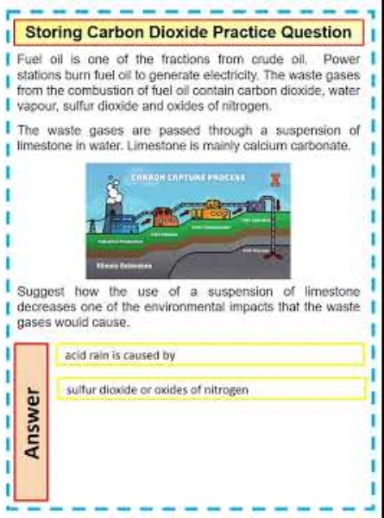
Storing Carbon Dioxide Practice Question

