Slide 1
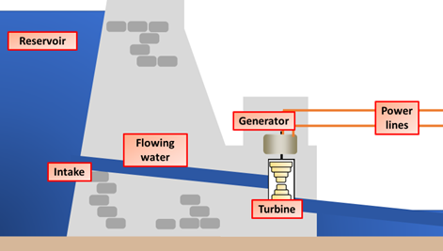
Hydroelectricity Question
The diagram below shows how electricity is generated using hydroelectricity
Mark Scheme
What force turns the turbines in a hydroelectric power station?
Is hydroelectricity a renewable or non-renewable energy source?
What is usually built to store water for hydroelectric power?
Name one environmental disadvantage of hydroelectric power.

