Slide 1
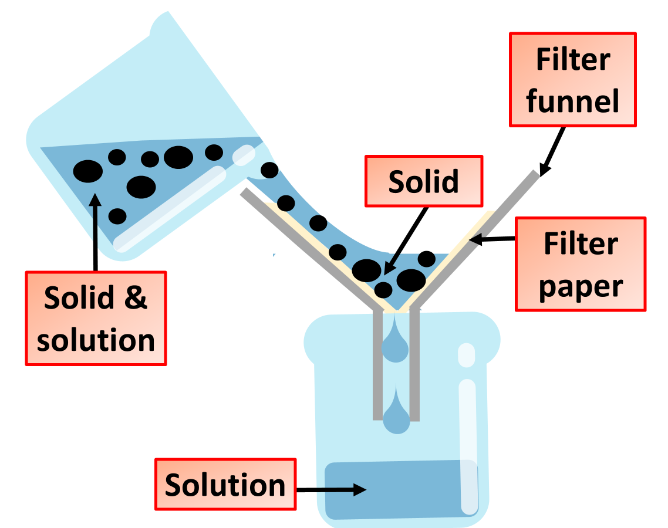

Separating Sand & Water Practice Question
Sand and water is an example of a mixture as the sand and the water are not chemically bonded together. Describe how you could separate a mixture of sand and water. Explain each step in the process.
Key things to include:
What equipment you are going to use
How the solid & the liquid are being separated
How the water will be collected
_____________________________________________________________________________________________________________________________________________________________________________________________________________________________________________________________________________________________________________________________________________________________________________________________________________________________________________________________________________________________________________________________________
Answer
Link to video

