Slide 1

Plant Tissues Question
Adult hornet moths lay eggs that hatch into larvae.
The larvae of the hornet moth
• live inside the roots of trees
• use the tree roots as a source of food
• cause damage to the tree roots.
Explain why a tree might die if the roots of the tree are damaged.
Key things to include:
How will water absorption be affected
How will absorbing less ions affect plants
What effect will damage to the phloem have
What effect will damage to the xylem have
______________________________________________________________________________________________________________________________________________________________________________________________________________________________________________________________________________________________________________________________________________________________________________________________________________________________________________________________________________________
Answer
Link to video

Slide 2
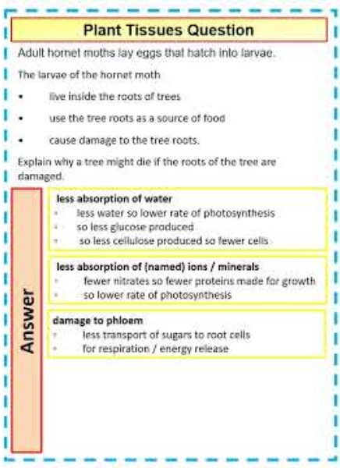
Plant Tissues Question

Slide 3

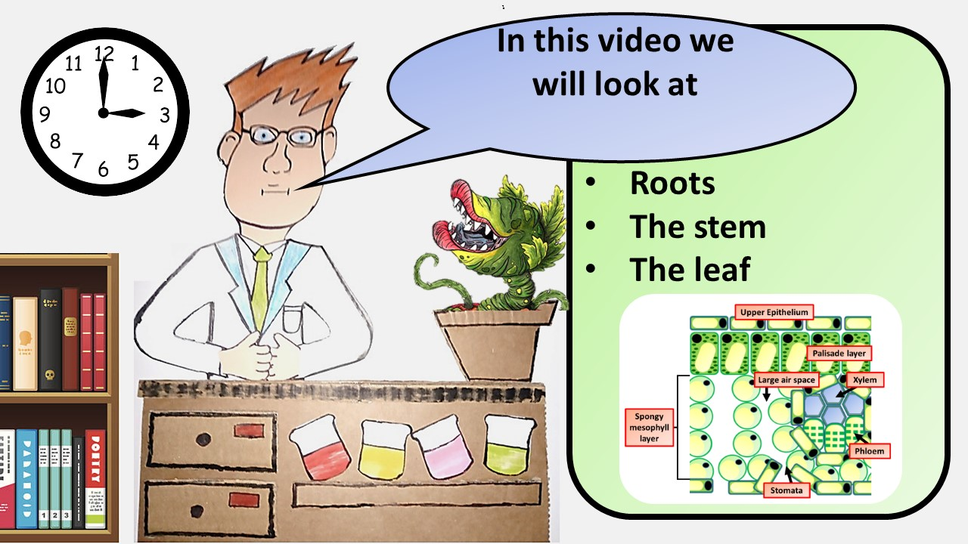


Click here to access my youtube videos
Resources that this activity would work well with
Lesson on TES
Lesson on TPT
Follow me on social media to stay in touch
Keep up to date with my new content:

