Slide 1
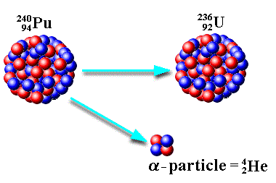

Radioactive Decay Question
Explain what is meant by radioactive decay and describe the changes that occur in an unstable nucleus during this process. (4 marks)
Key things to include:
What happens during alpha decay
What happens during beta decay
What happens during gamma decay
___________________________________________________________________________________________________________________________________________________________________________________________________________________________________________________________________________________________________________________________________________________________________________________________________________________________________________________________________________________________________________________________________________________________________________________________________________________________________
Answer
Link to video

