Slide 1
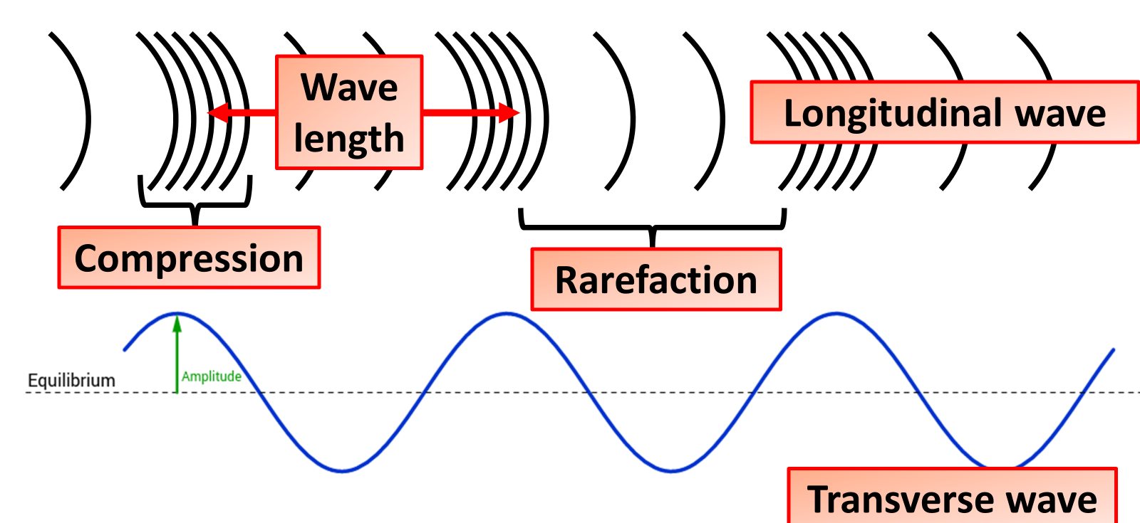

Types of Waves Practice Question
Waves may be longitudinal or transverse.
What type of wave is light?
Mark Scheme
What type of wave is sound?
Which type of wave moves particles perpendicular to the direction of energy transfer?
Which type of wave moves particles parallel to the direction of energy transfer?

