Slide 1


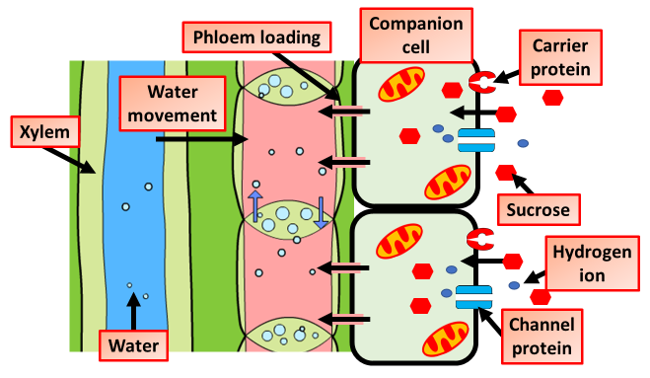
The Great Biology Pubish Quiz
Translocation

Slide 2

The Great Biology Pubish Quiz
Translocation
What tissue is responsible for translocation in plants?
A
Xylem
Phloem
B
C
Cambium
D
Epidermis

Slide 3
The Great Biology Pubish Quiz
Translocation
Which type of cells mainly carry out translocation?
A
Tracheids
Parenchyma
B
C
Companion
D
Sieve

Slide 4
The Great Biology Pubish Quiz
Translocation
In which direction does translocation occur?
A
Down
Up
B
C
Both
D
Out

Slide 5
The Great Biology Pubish Quiz
Translocation
What is the main organic molecule transported by translocation?
A
Glucose
Fructose
B
C
Sucrose
D
Starch

Slide 6
The Great Biology Pubish Quiz
Translocation
What is the name of the theory that explains translocation?
A
Capillarity
B
Cohesion
C
Pressure
D
Osmosis

Slide 7
The Great Biology Pubish Quiz
Translocation
Where are assimilates transported from in translocation?
A
Sink
Leaf
B
C
Root
D
Phloem

Slide 8

The Great Biology Pubish Quiz
Translocation
Question 1
B
Question 2
D
Question 3
C
Question 4
C
Question 5
C
Question 6
B

