Slide 1
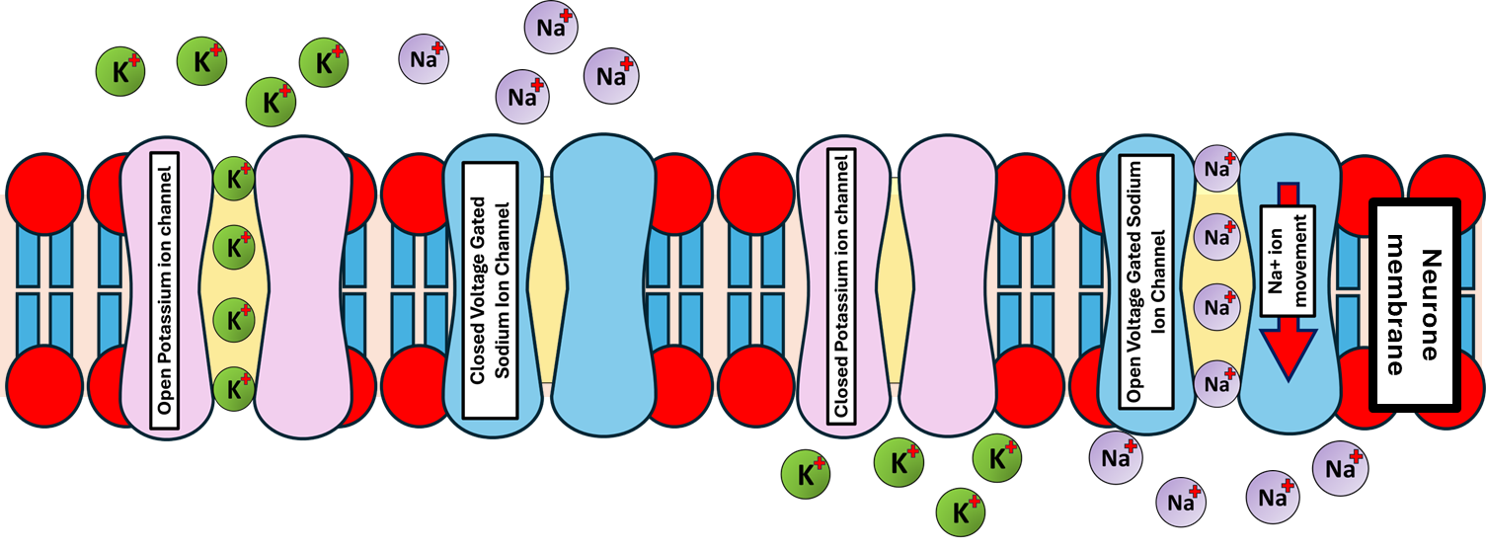
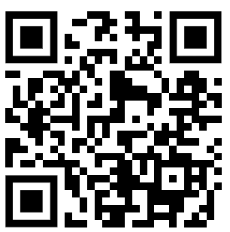
The Effect of Neurotoxins Question
A neurotoxin blocks sodium ion channels on the neuron membrane, preventing sodium ions from entering the cell.
Explain how this neurotoxin would affect nervous transmission and the generation of an action potential.
___________________________________________________________________________________________________________________________________________________________________________________________________________________________________________________________________________________________________________________________________________________________________________________________________________________________________________________________________________________________________________________________________________________________________________________________________________________________________
Answer
Link to video

