Slide 1
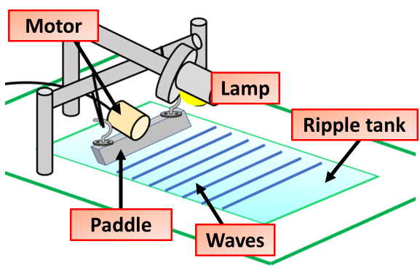
Ripple Tank Practice Question
Students can investigate the properties of waves using a ripple tank.
Describe a method the student could use to calculate wave speed using the equipment above
Key things to include:
Dependent variables
Independent variables
Control variables
_______________________________________________________________________________________________________________________________________________________________________________________________________________________________________________________________________________________________________________________________________________________________________________________________________________________________________
Answer
Link to video

Slide 2
Ripple Tank Practice Question

