Slide 1
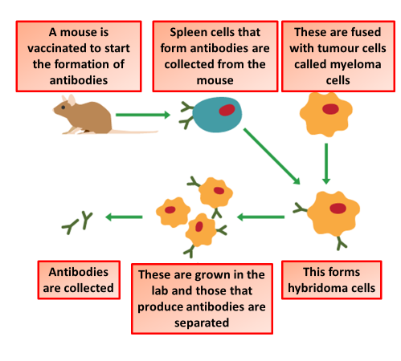

Monoclonal Antibodies Question
Describe how monoclonal antibodies are produced
Key things to include:
What is injected into a mouse
What is removed form the mouse
How is a hybridoma produced
_______________________________________________________________________________________________________________________________________________________________________________________________________________________________________________________________________________________________________________________________________________________________________________________________________________________________________
Answer
Link to video

