Slide 1
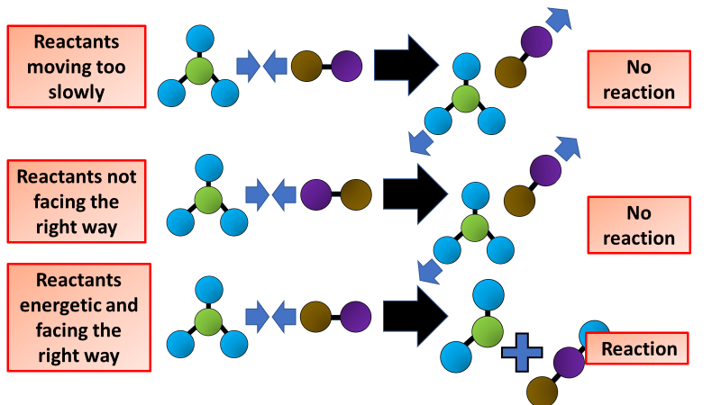

Collision Theory Question
The diagram shows how reactions take place
Video link
What does collision theory explain?
What must particles do for a reaction to happen?
What is the minimum energy needed for a successful collision called?
How can the rate of reaction be increased?

