Slide 1


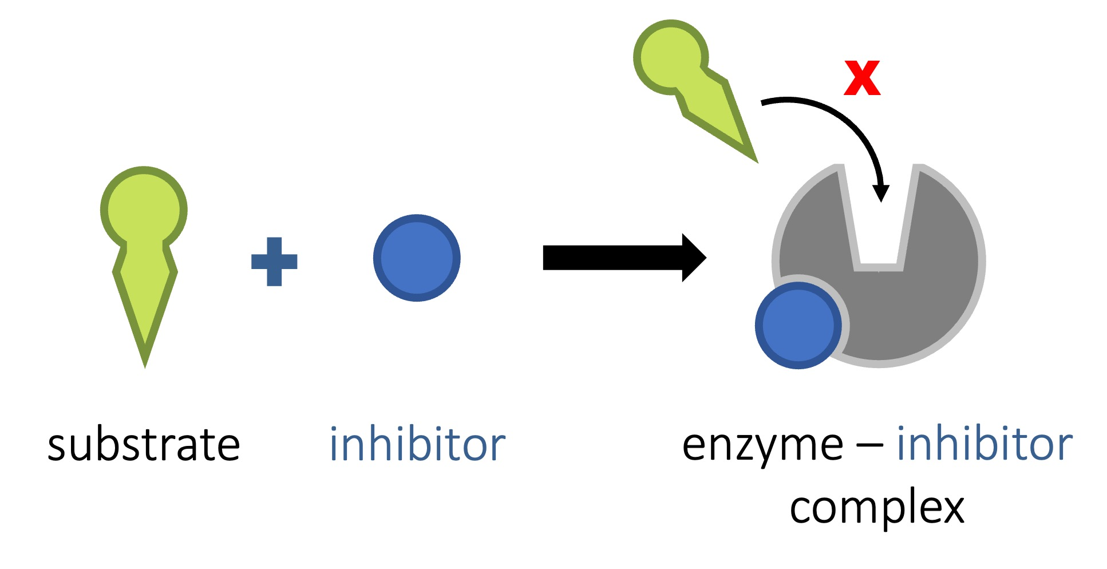
The Great Biology Pubish Quiz
Enzyme Inhibition

Slide 2

The Great Biology Pubish Quiz
Enzyme Inhibition
Which type of inhibitor binds to the active site of an enzyme?
A
Non-competitive
Allosteric
B
C
Competitive
D
Irreversible

Slide 3
The Great Biology Pubish Quiz
Enzyme Inhibition
What effect does a non-competitive inhibitor have on Vmax?
A
Increases it
Decreases it
B
C
No change
D
Doubles it

Slide 4
The Great Biology Pubish Quiz
Enzyme Inhibition
Where does a non-competitive inhibitor bind on the enzyme?
A
Active site
Substrate
B
C
Product site
D
Allosteric site

Slide 5
The Great Biology Pubish Quiz
Enzyme Inhibition
What is a characteristic of competitive inhibition?
A
Inhibitor is permanently bound
Inhibitor changes enzyme shape
B
C
Can be overcome by more substrate
D
Works only at high temperature

Slide 6
The Great Biology Pubish Quiz
Enzyme Inhibition
Which of the following best describes enzyme inhibition?
A
Decrease in enzyme activity
Permanent destruction of enzymes
B
C
Prevention of cofactor binding
D
Increase in substrate concentration

Slide 7
The Great Biology Pubish Quiz
Enzyme Inhibition
Which of the following is an example of a metabolic poison that acts as an enzyme inhibitor?
A
Oxygen
B
Cyanide
C
Water
D
Sodium

Slide 8

The Great Biology Pubish Quiz
Enzyme Inhibition
Question 1
C
Question 2
B
Question 3
D
Question 4
C
Question 5
A
Question 6
B

