Slide 1
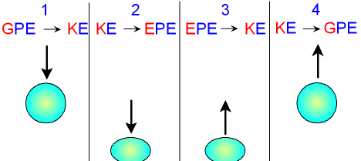
Energy Transfer Question
The diagram below shows energy transfers when a ball is dropped
What type of energy does a ball have at its highest point before falling?
What energy transfer happens as the ball falls?
What type of energy is mostly lost when the ball hits the ground?
Why does the ball not bounce back to its original height?

