Slide 1

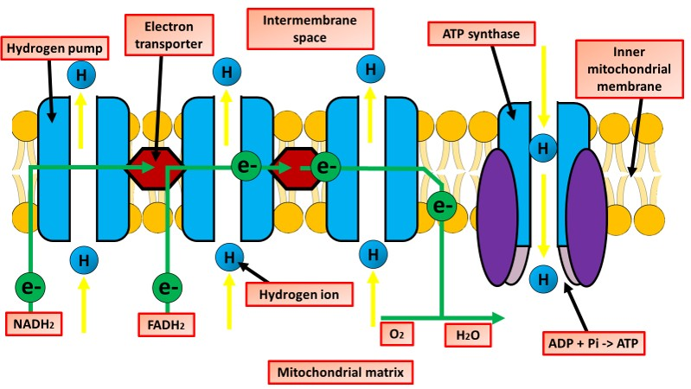

The Great Biology Pubish Quiz
Oxidative Phosphorylation

Slide 2
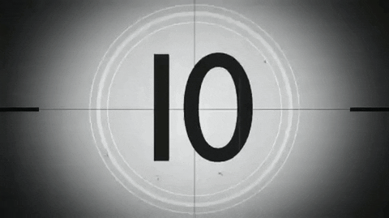
The Great Biology Pubish Quiz
Oxidative Phosphorylation
Which structure in the mitochondrion is the site of oxidative phosphorylation?
A
Outer membrane
Inner membrane
B
C
Matrix
D
Cristae

Slide 3
The Great Biology Pubish Quiz
Oxidative Phosphorylation
What is the final electron acceptor in oxidative phosphorylation?
A
ATP
B
CO₂
C
Oxygen
D
Water

Slide 4
The Great Biology Pubish Quiz
Oxidative Phosphorylation
Which molecule donates electrons to the electron transport chain?
A
NADH
ADP
B
C
Glucose
D
CO₂

Slide 5
The Great Biology Pubish Quiz
Oxidative Phosphorylation
What process drives ATP production during oxidative phosphorylation?
A
Photolysis
Chemiosmosis
B
C
Glycolysis
D
Hydrolysis

Slide 6
The Great Biology Pubish Quiz
Oxidative Phosphorylation
Where do the protons accumulate during oxidative phosphorylation?
A
Cytoplasm
Matrix
B
C
Intermembrane space
D
Cristae

Slide 7
The Great Biology Pubish Quiz
Oxidative Phosphorylation
Which enzyme synthesises ATP in oxidative phosphorylation?
A
Catalase
B
Rubisco
C
Hexokinase
D
ATP synthase

Slide 8

The Great Biology Pubish Quiz
Oxidative Phosphorylation
Question 1
B
Question 2
C
Question 3
A
Question 4
B
Question 5
C
Question 6
D

