Slide 1

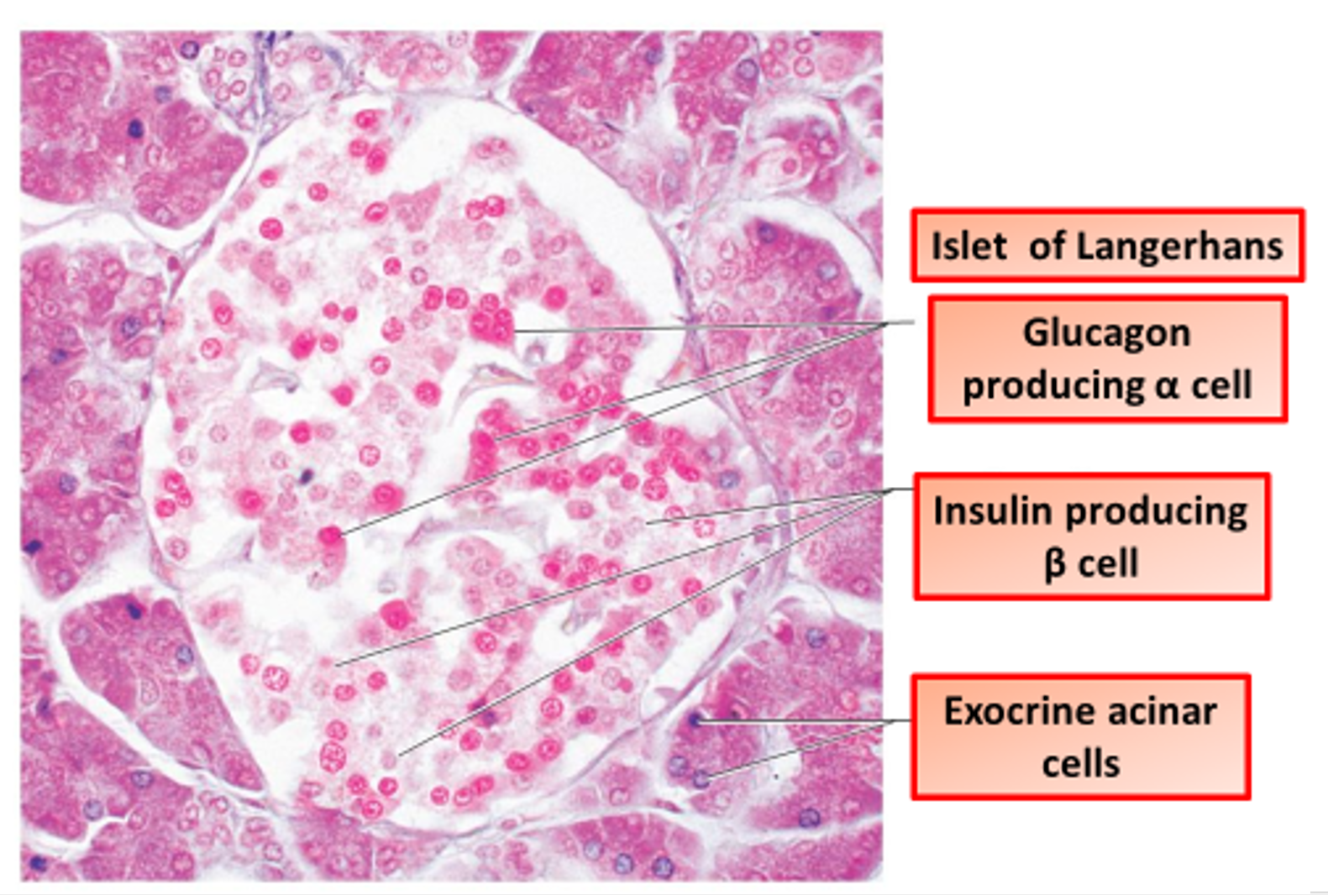

The Great Biology Pubish Quiz
Structure of the Pancreas

Slide 2

The Great Biology Pubish Quiz
Structure of the Pancreas
What is the main function of the islets of Langerhans in the pancreas?
A
Produce digestive enzymes
Regulate blood glucose levels
B
C
Store glycogen
D
Produce bile

Slide 3
The Great Biology Pubish Quiz
Structure of the Pancreas
Which type of cells in the islets of Langerhans secrete insulin?
A
Alpha cells
Beta cells
B
C
Delta cells
D
Acinar cells

Slide 4
The Great Biology Pubish Quiz
Structure of the Pancreas
What is the primary function of the exocrine part of the pancreas?
A
Secretion of hormones
Production of insulin
B
C
Secretion of digestive enzymes
D
Regulation of blood pressure

Slide 5
The Great Biology Pubish Quiz
Structure of the Pancreas
Which hormone is secreted by alpha cells in the pancreas?
A
Insulin
Somatostatin
B
C
Amylase
D
Glucagon

Slide 6
The Great Biology Pubish Quiz
Structure of the Pancreas
What structures in the pancreas carry digestive enzymes to the duodenum?
A
Blood vessels
Bile ducts
B
C
Pancreatic ducts
D
Islets of Langerhans

Slide 7
The Great Biology Pubish Quiz
Structure of the Pancreas
Which of the following is part of the endocrine function of the pancreas?
A
Secretion of insulin and glucagon
Production of bile
B
C
Production of trypsin
D
Secretion of bicarbonate ions

Slide 8

The Great Biology Pubish Quiz
Structure of the Pancreas
Question 1
B
Question 2
B
Question 3
C
Question 4
D
Question 5
C
Question 6
A

