Slide 1
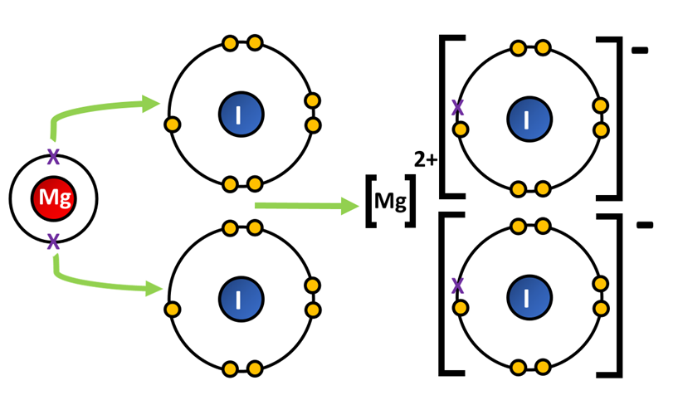

Ionic Bonding Question
The diagram shows how ionic bonds form:
Video link
What types of elements form ionic bonds?
What happens to electrons in ionic bonding?
What holds the ions together in an ionic compound?
Why do solid ionic compounds not conduct electricity?

