Slide 1
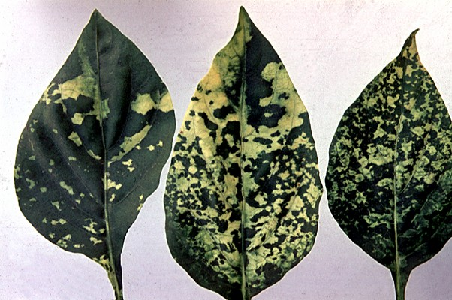
Effect of TMV on Plants Question
The diagram shows a plant suffering from TMV. Explain why plants infected with Tobacco Mosaic Virus (TMV) have stunted growth.
Video Link
Key things to include:
What effect does TMV have on chlorophyll
What issues does a lack of chlorophyll cause plants
_______________________________________________________________________________________________________________________________________________________________________________________________________________________________________________________________________________________________________________________________________________________________________________________________________________________________________
Answer

