Slide 1

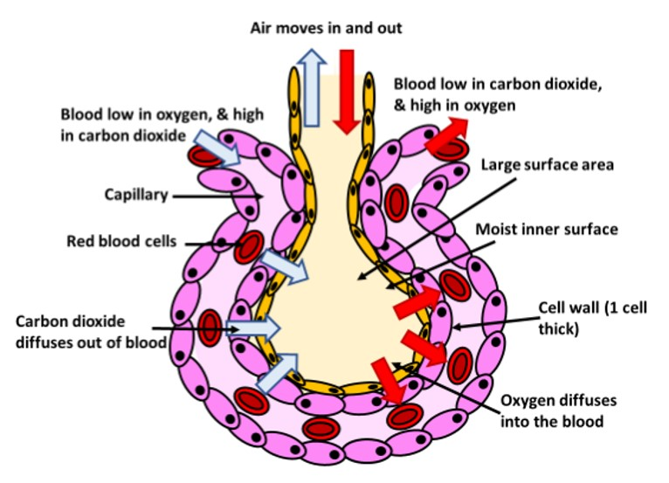

The Great Biology Pubish Quiz
Round 4: Alveoli

Slide 2

The Great Biology Pubish Quiz
Round 3
What is the primary function of alveoli in the respiratory system?
A
To transport oxygen around the body
To store carbon dioxide
B
C
To facilitate gas exchange between air and blood
D
To produce mucus in the lungs

Slide 3
The Great Biology Pubish Quiz
Round 3
Which feature of alveoli helps to maximize the efficiency of gas exchange?
A
Thick walls to support structure
Large surface area due to numerous small sacs
B
C
High concentration of muscle fibres
D
Impermeable membrane

Slide 4
The Great Biology Pubish Quiz
Round 4
Which of the following structures is directly associated with alveoli?
A
Trachea
Bronchi
B
C
Capillaries
D
Diaphragm

Slide 5
The Great Biology Pubish Quiz
Round 4
How does the thinness of alveolar walls aid in their function?
A
It reduces the surface area for gas exchange
It allows rapid diffusion of gases
B
C
It helps to store oxygen
D
It prevents gas exchange

Slide 6
The Great Biology Pubish Quiz
Round 4
Which gas diffuses from the alveoli into the blood during gas exchange?
A
Carbon monoxide
Carbon dioxide
B
C
Nitrogen
D
Oxygen

Slide 7
The Great Biology Pubish Quiz
Round 4
Why is there a thin layer of moisture on the alveolar surface?
A
To prevent dehydration of lung tissue
To dissolve gases, facilitating their diffusion
B
C
To trap dust particles
D
To maintain a low pH

Slide 8

The Great Biology Pubish Quiz
Round 3
Question 1
C
Question 2
B
Question 3
C
Question 4
B
Question 5
D
Question 6
B

