Slide 1
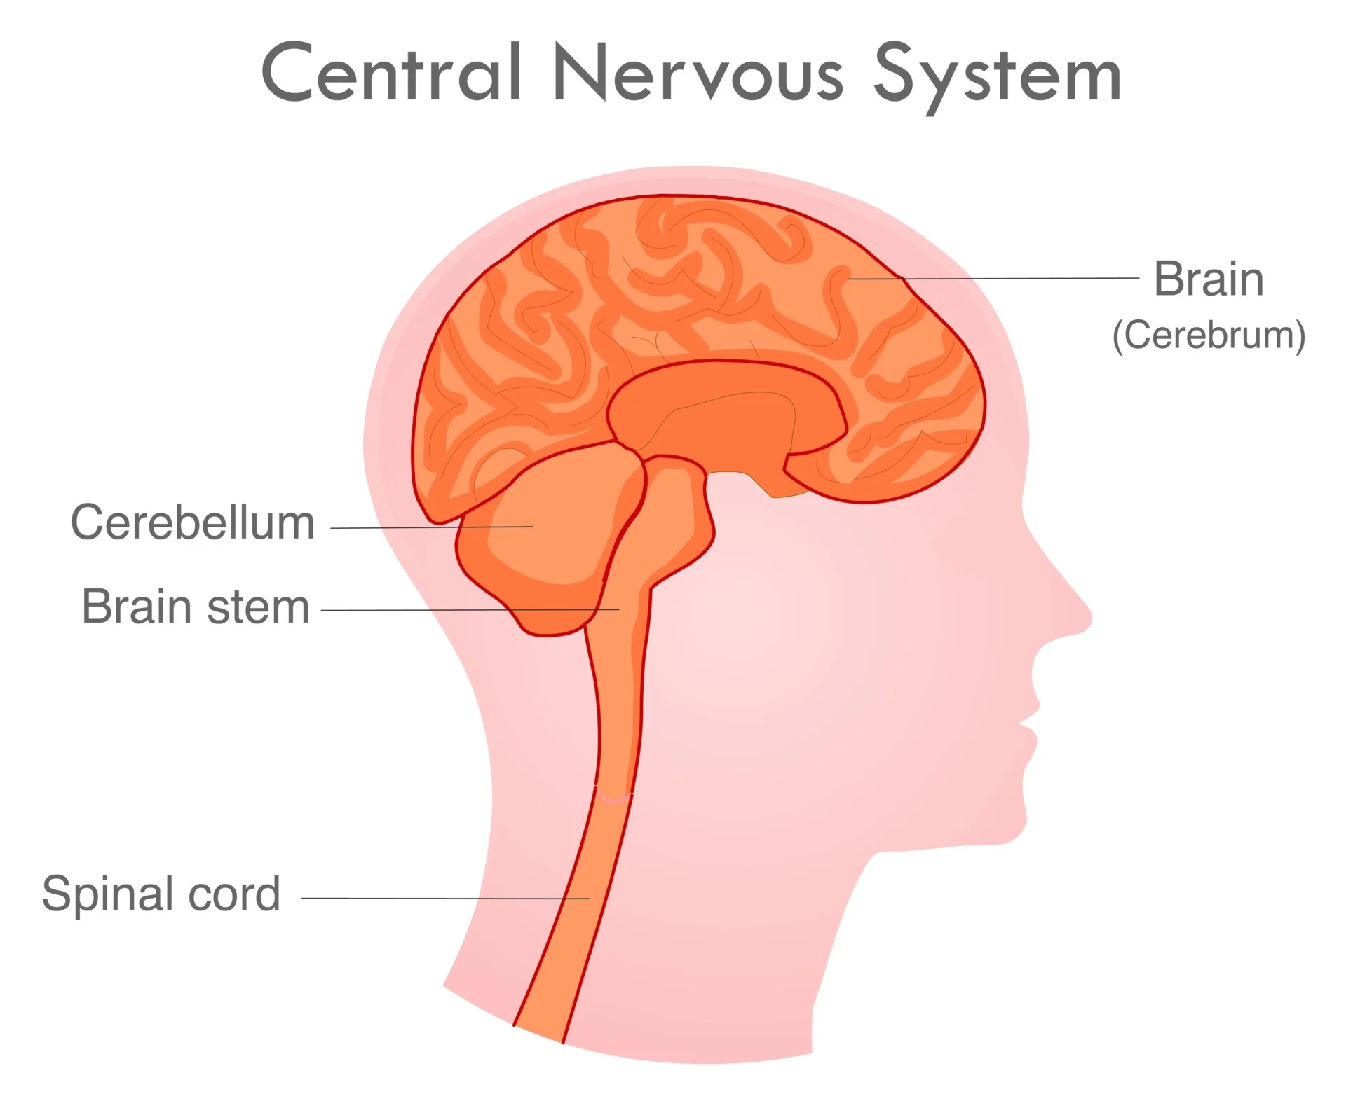

CNS Question
Describe the role of the central nervous system (CNS) in the human body
Key things to include:
What the CNS is
The function of the CAN
What reflexes are
_______________________________________________________________________________________________________________________________________________________________________________________________________________________________________________________________________________________________________________________________________________________________________________________________________________________________________
Answer
Link to video

