Slide 1
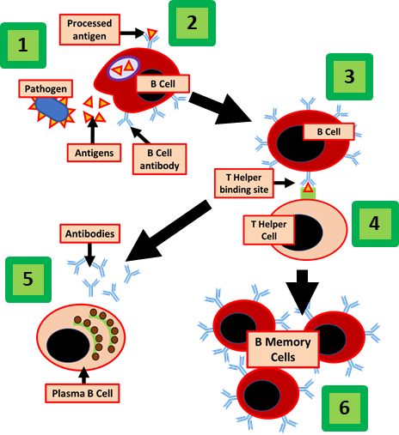
Antibody Production Stop Motion Video Instructions
Specification Link:
4.3 Infection and Response
Stop motion is an animated filmmaking technique in which objects are physically manipulated in small increments between individually photographed frames so that they will appear to exhibit independent motion or change when the series of frames is played back.
Story Boarding is the first step which it may storyboarding but it vital to get the video done with little to no mistakes
To have a great video never use the sun as your light, this will lead to odd lighting in the background witch distracts the views of your video. Use any type of light you have that’s not the sun such as the photo above for good video
Background information
Play around with the angle and don’t keep it still move around sloooowly for a more interesting movie effect.
When taking photos you want a still shot i recommend using a book or box the will hold your phone as you move the camera or keep it still
if your on a Apple Device you can hit the sound button to take photo so press that instead of the screen for less movement..
Check everything then double check you don’t want to mess up and restart..
The lymphocyte moves towards the pathogen. It then breaks it down by phagocytosis
Checklist: Before you start have you got the following
Part of the pathogen called an antigen is attached to a protein on the B lymphocyte cell surface
Done | Have you got
 | Enough information on the topic your video is based on
 | A list of potential information or key points you’ll need to include
 | An idea of what your video is going to look like
 | All of the equipment you need to make your video
A T lymphocyte will bind to the B lymphocyte activating it
The B lymphocyte turns into a plasma B cell
The plasma B cell can produce lots of antibodies which will bind onto the antigens of the surfaces of the pathogens
Some of the B cells turn into memory B cells so that the next time you come into contact with that antigen again you will have a much faster immune response
Link to an example video:
https://drive.google.com/open?id=1sM1zjs7QtTRzN5o-y6zYRrKYnxEgevZw

