Slide 1
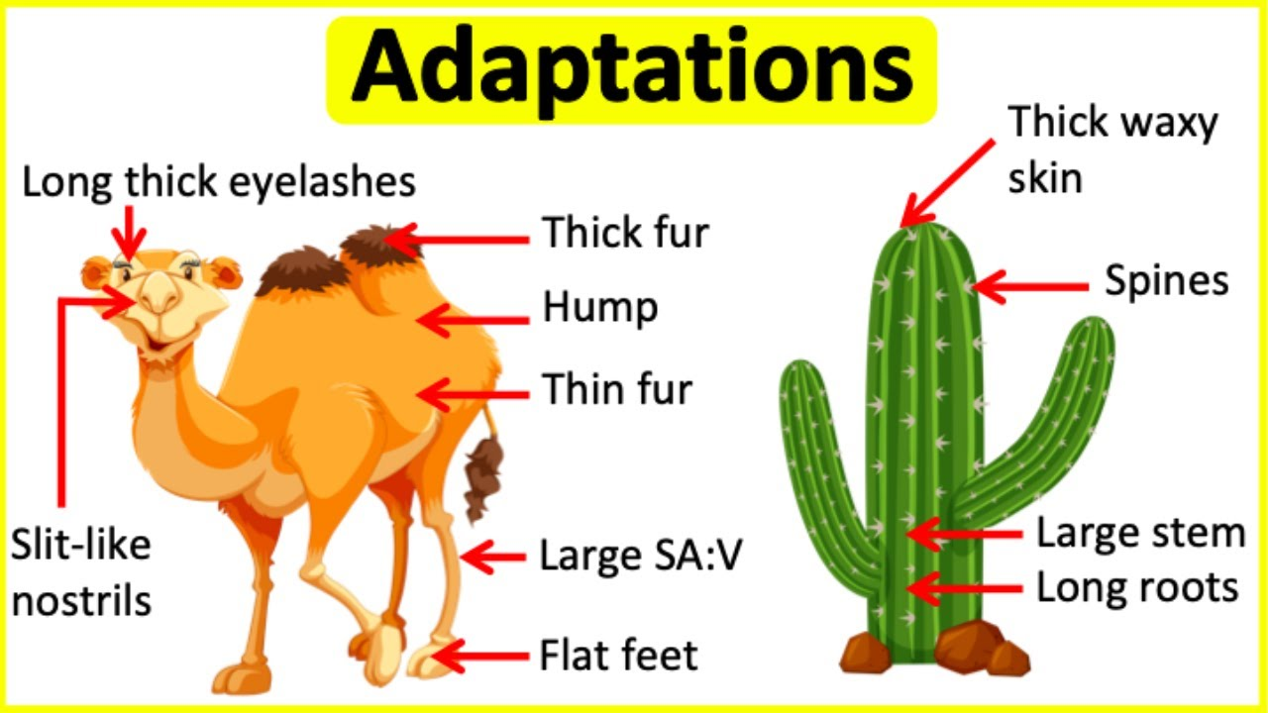

Adaptations Question
Explain how adaptations help organisms survive in their environment.
Key things to include:
What adaptations help animals
What adaptations help plants
If organisms survive what can they do
_______________________________________________________________________________________________________________________________________________________________________________________________________________________________________________________________________________________________________________________________________________________________________________________________________________________________________
Answer
Link to video

